Slide 1
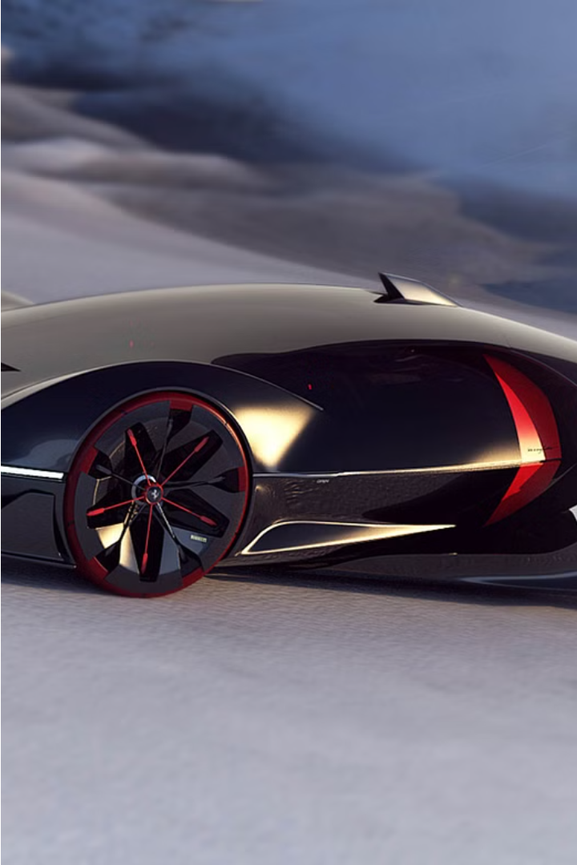


Designing Concept Cars
Concept cars are experimental vehicle designs that push the boundaries of automotive engineering and styling. These visionary prototypes allow automakers to showcase their latest technologies, innovative features, and bold design ideas.
by BHARATHI.M

Slide 2
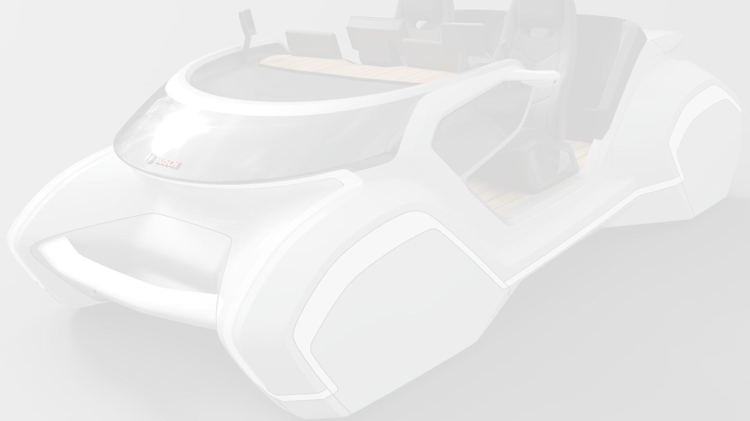
Defining Concept Cars
1
Futuristic Styling
2
Advanced Technologies
3
Visionary Concepts
Concept cars often feature cutting-edge exterior and interior designs, with bold shapes, unique proportions, and advanced materials.
These vehicles incorporate emerging automotive technologies, such as electric powertrains, autonomous driving features, and human-machine interfaces.
Concept cars are not intended for mass production, but rather to showcase a brand's vision for the future of mobility.

Slide 3

The Design Process
Ideation
1
Designers and engineers brainstorm bold, innovative ideas that push the boundaries of what's possible.
2
Sketching
Concepts are expressed through quick sketches and renderings to explore different design directions.
Modeling
3
3D modeling and clay sculpting bring the designs to life, allowing for refinement and testing of ideas.

Slide 4
Inspiration and Ideation
Nature's Influence
Sci-Fi Visions
Cultural Trends
Futuristic movies, books, and technology trends can spark imaginative ideas for concept car designs.
Concept cars may also reflect societal shifts, such as sustainability, autonomy, and the changing role of the automobile.
Concept car designers often take inspiration from the natural world, incorporating organic shapes and biomimetic principles.

Slide 5
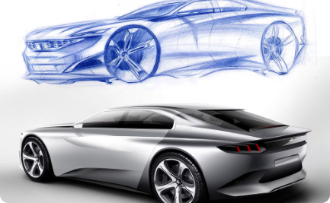
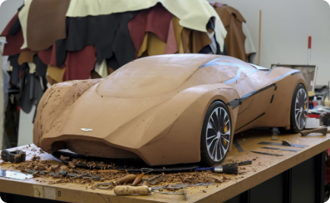
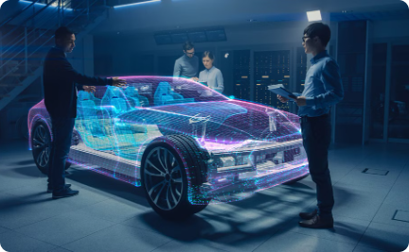
Sketching and Modeling
Sketching
3D Modeling
Virtual Prototyping
Designers use quick sketches and digital renderings to explore and refine their ideas, capturing the essence of the concept.
Physical clay models and 3D digital models allow designers to bring their concepts to life, experimenting with form and proportions.
Advanced modeling and simulation tools enable designers to test their concepts in virtual environments before building physical prototypes.

Slide 6
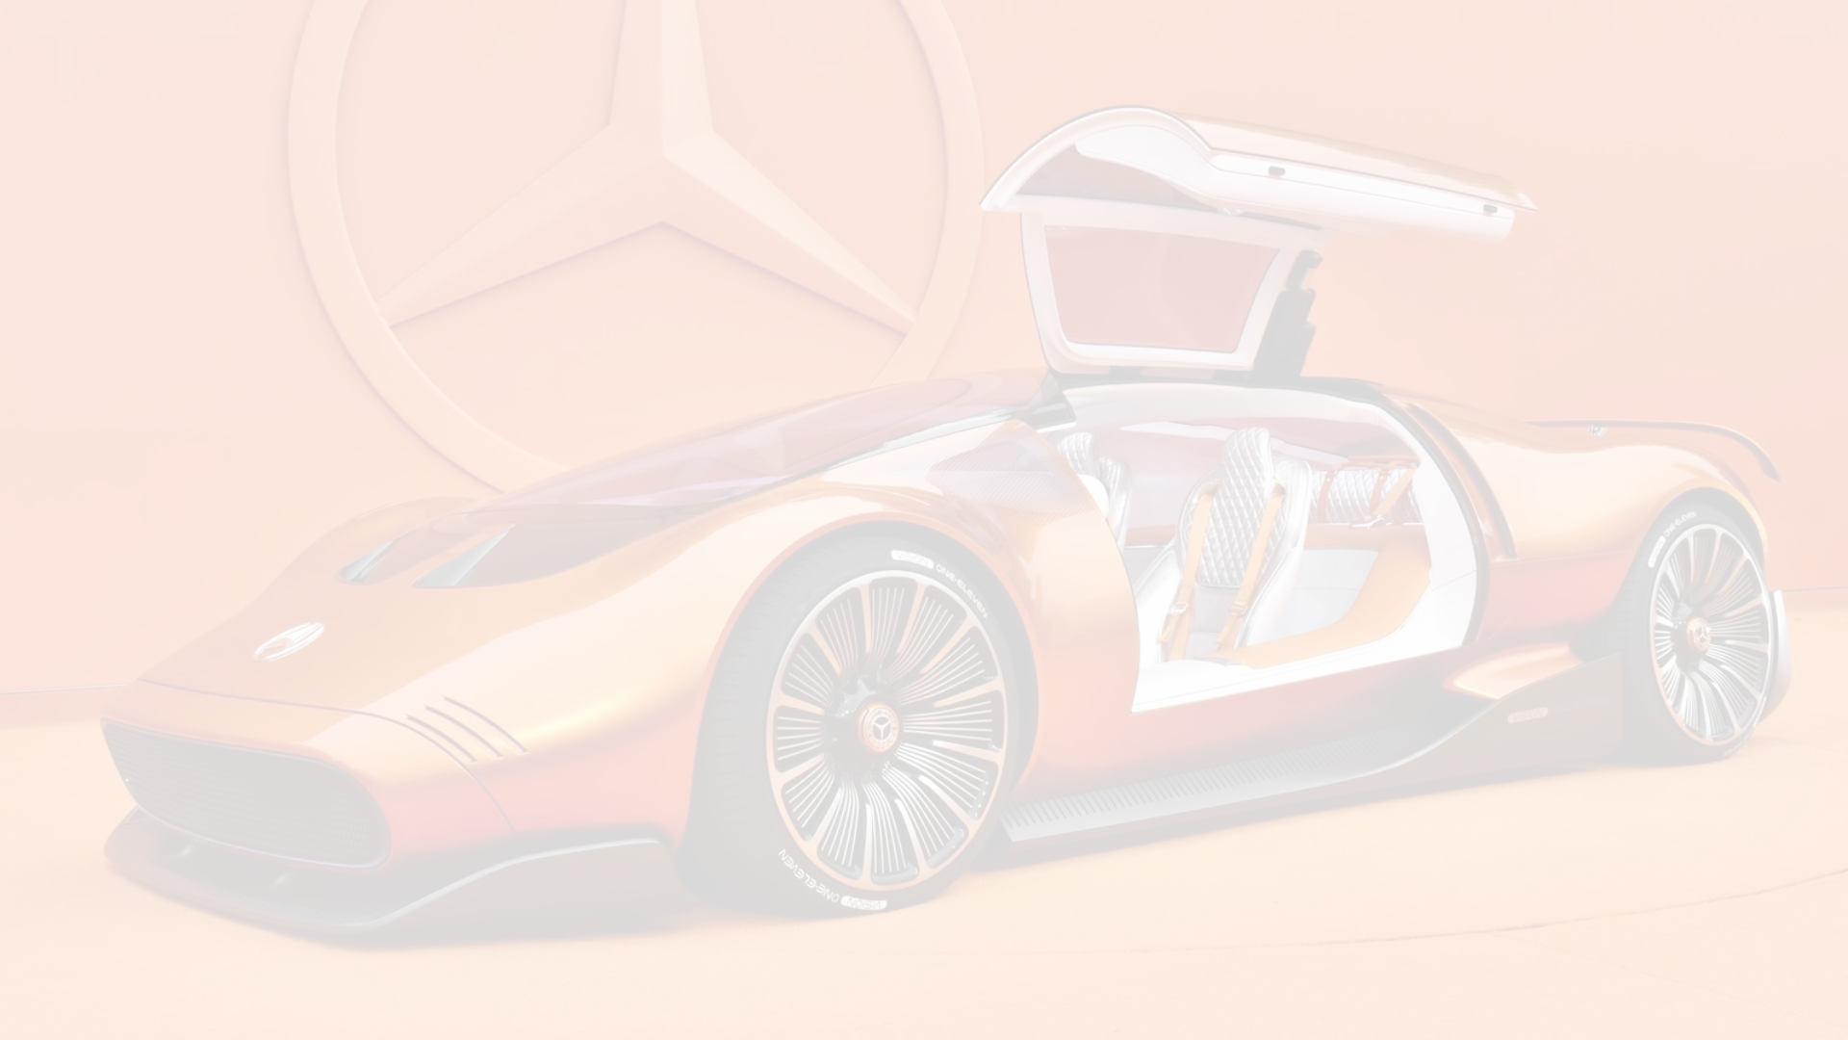



Prototyping and Testing
Rapid Prototyping
Virtual Evaluation
Real-World Testing
3D printing and other rapid manufacturing techniques allow for the quick creation of physical prototypes to test and refine designs.
Simulations and digital models help assess the performance, safety, and user experience of concept cars before physical builds.
Concept cars are put through their paces on tracks and roads, providing valuable feedback to further improve the designs.

Slide 7




Incorporating Emerging Technologies
Electric Powertrains
Autonomous Features
Innovative Interfaces
Sustainable Design
Concept cars showcase the latest advancements in electric vehicle technology, including high-performance motors and long-range batteries.
Concept cars often integrate self-driving capabilities, advanced sensors, and artificial intelligence to enhance the driving experience.
Concept cars feature cutting-edge human-machine interfaces, incorporating voice control, gesture recognition, and augmented reality displays.
Concept cars are exploring the use of eco-friendly materials, such as recycled plastics and plant-based composites, to reduce environmental impact.

Slide 8
The Future of Concept Car Design
Personalization
Seamless Connectivity
Concept cars will likely offer increased customization and personalization options, allowing owners to tailor their vehicles to their unique preferences.
Future concept cars will integrate seamlessly with smart home and personal devices, creating a more connected and data-driven driving experience.
Shared Mobility
Sustainable Innovation
Concept cars may explore new ownership models and shared mobility solutions, responding to the changing transportation needs of urban populations.
Concept cars will continue to push the boundaries of sustainable design, incorporating renewable energy sources and closed-loop manufacturing processes.

